Slide 1


Random Forest
Random Forest models excel in ensemble learning, providing robustness and accuracy. They identify feature importance and allow tuning of hyperparameters to enhance predictive performance in various datasets.
Ensemble of decision trees → averages predictions
Handles non-linearities, outliers, feature interactions
Emits feature importance scores for interpretation
Hyper-parameters: n_estimators (≈200), depth, sample ratios

Slide 2
Essential Regression Metrics
Metric | Formula | Insight
MAE | mean | y – ŷ
RMSE | √mean((y – ŷ)²) | Penalizes large errors
R² | 1 – SSₑ/SSₜ | Variance explained (0–1)
Visual representation of essential regression metrics for analysis

Slide 3


Actual vs Predicted
01
Residuals
02
Diagnostic Plots
Feature Importance
03

Slide 4

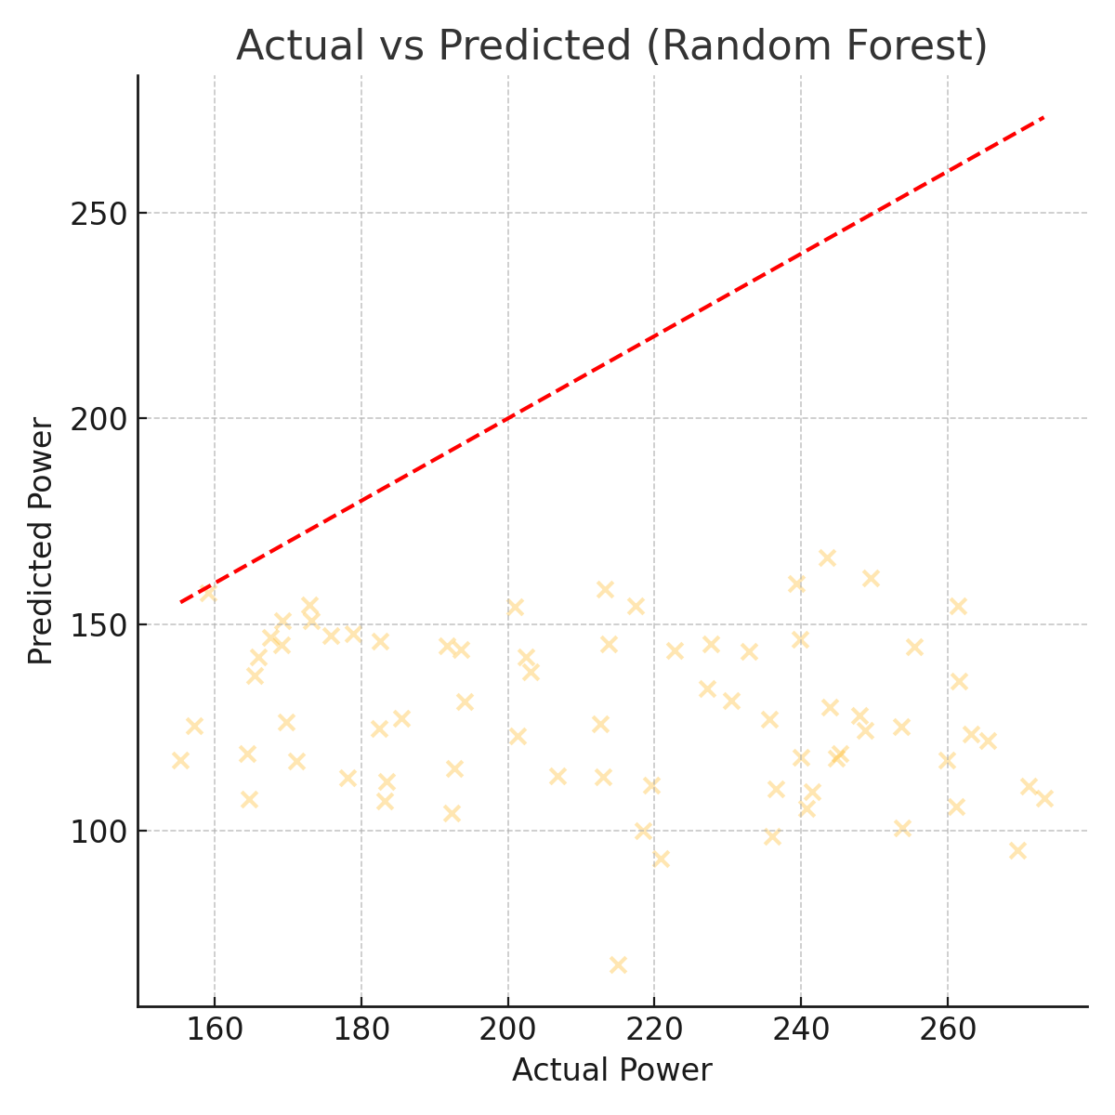
Actual vs Predicted
Purpose: Checks the linearity and bias of the model.
Interpretation: Ideally, points should lie close to the red diagonal line (perfect predictions). In this plot, the predictions are consistently underestimating the true values, indicating a potential bias in the model or missing features.

Slide 5
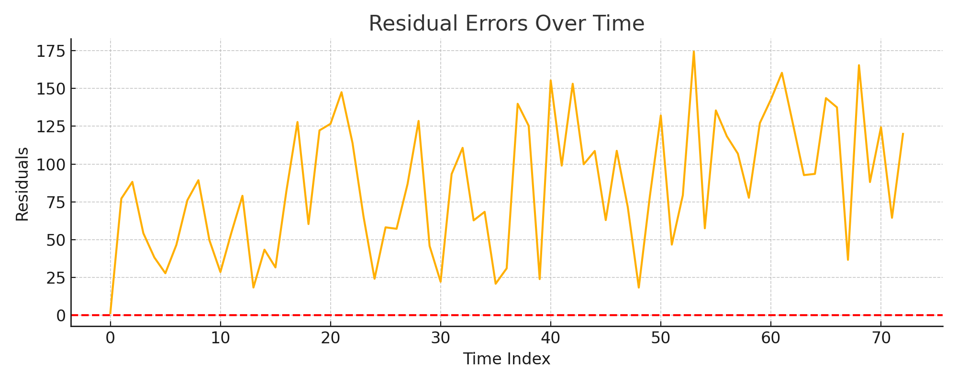
Residuals
Purpose: Detects non-stationarity, drift, or time-dependent error patterns.
Interpretation: Residuals fluctuate with time and seem to increase in variability, which may suggest model performance degrades over certain periods, potentially due to unmodeled temporal dynamics or external factors.

Slide 6
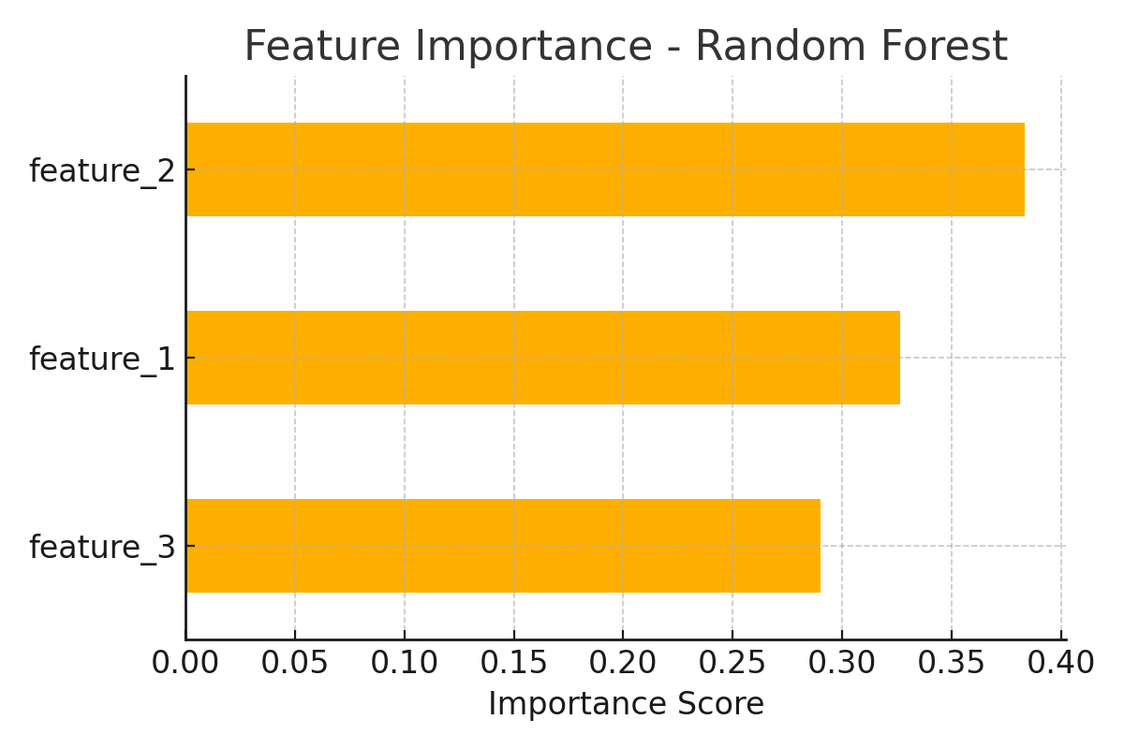
Feature Importance
Purpose: Identifies which features most influence model predictions.
Interpretation: feature_2 and feature_1 are the top drivers of energy consumption in the current Random Forest model, indicating they carry the most predictive power..

Slide 7
Baseline Comparison Cheat-Sheet
Model | Non-linear? | Importance? | Interpretability | Overfit Risk
OLS | ✘ | ✘ | ★★★★★ | Low
Random Forest | ✔ | ✔ | ★★☆☆☆ | Moderate-Low

Slide 8





Moving Forward in ML
1. Build baselines first → validate data & metrics
2. Choose OLS for clarity, RF for power
3. Next: hyper-parameter tuning & cross-validation
Key takeaways and strategies for advancing your machine learning journey

Slide 9


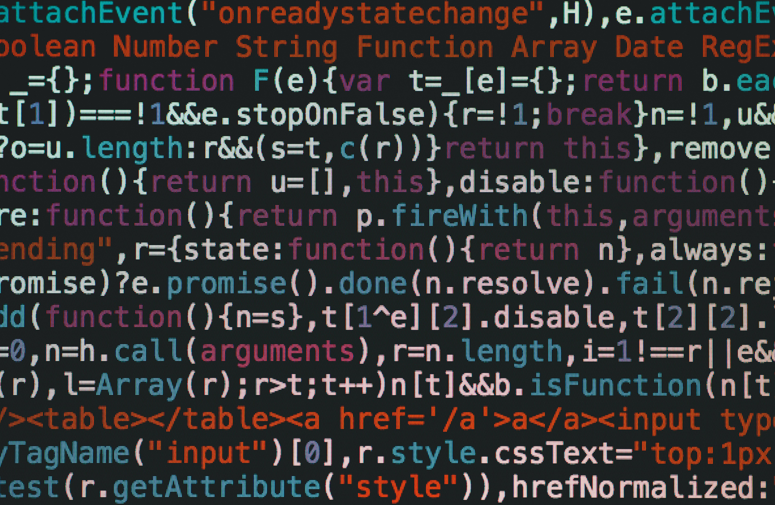
Thank You For Listening

